Slide 1
Website design and sell
Class Name: SE01
Instructor: Võ Công Đình
Group Name: Group 4
Members: Võ Thị Thanh Huyền
Nguyễn Thuỳ Linh
Trương Công Hiếu

Slide 2
OBJECTIVES
1
Introduction to project
2
Customer requirements
3
Use case
4
Activity diagram
5
Class diagram
6
Sequence diagram
7
Entity relationship diagram
8
UI Design
9
Task assigment (to each group member)
10
Experience learned

Slide 3


INTRODUCTION TO PROJECT
Website selling consumer goods online under the new model of Affiliate Marketing. On the website, the admin puts the original product and original product information on the website by type and price.
The seller will choose the appropriate model and edit the template to his liking and then post it for sale on his own registered shop, the seller can add, delete the products in the shop.
Customers can view information about products, make purchases, and can add, update, repair, delete in their shopping cart. The amount from the sale of the product will partially pay for the original product that the system has posted, the profit will be transferred to the shop.

Slide 4
CUSTOMER REQUIREMENTS
CUSTOMER REQUIREMENT
Product requirements
User (client) functionality requirements
System administrator (admin) requirements
System functional requirements
Shipping requirements
Interface requirements

Slide 5
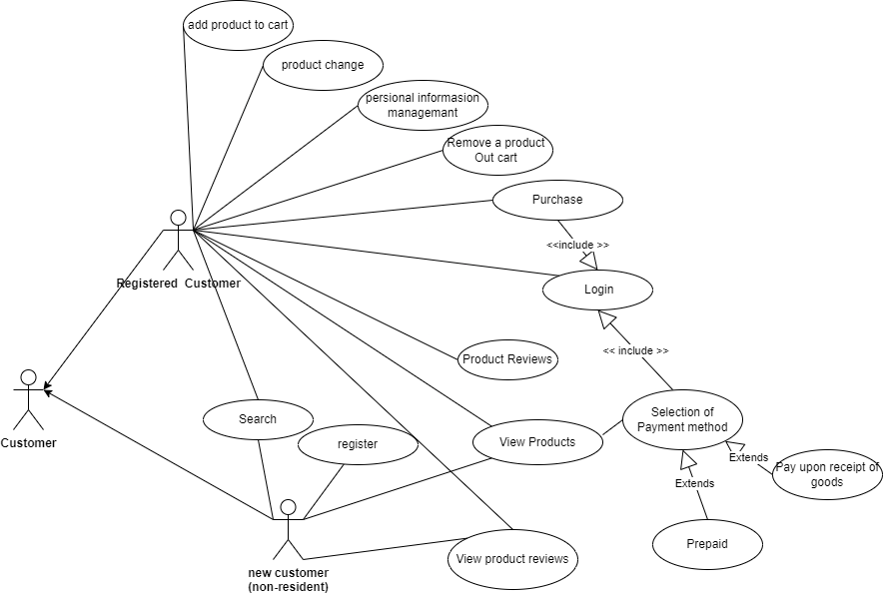
USE CASE

Slide 6
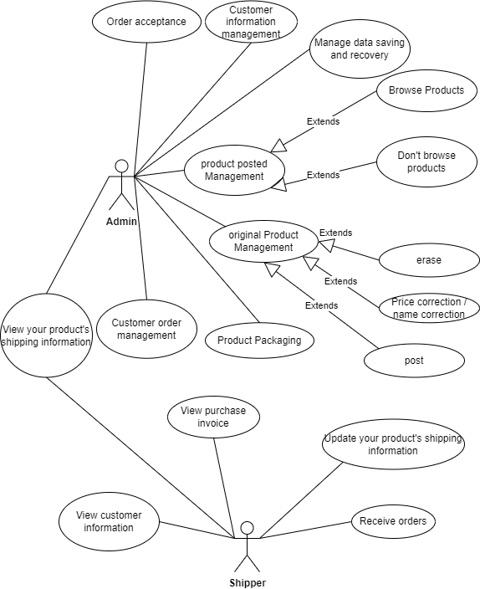
USE CASE

Slide 7
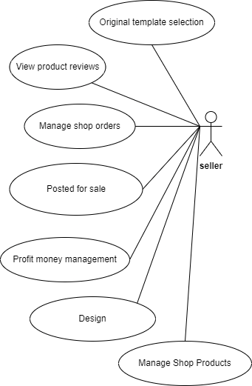
USE CASE

Slide 8
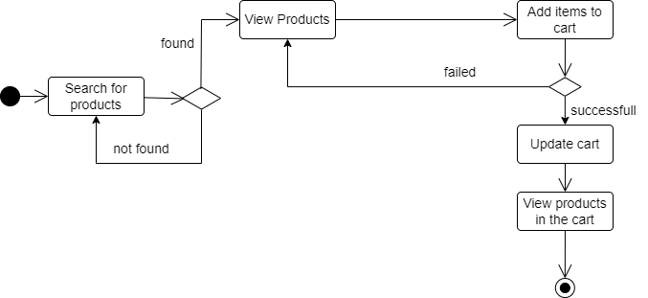
ACTIVITY DIAGRAM
1.Add to cart

Slide 9
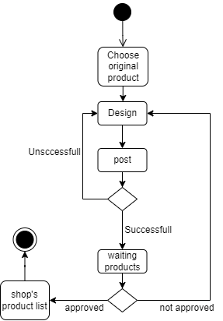
ACTIVITY DIAGRAM
2.Post products

Slide 10
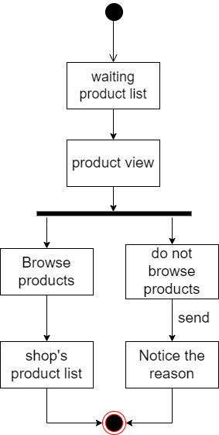
ACTIVITY DIAGRAM
3.Browse products

Slide 11
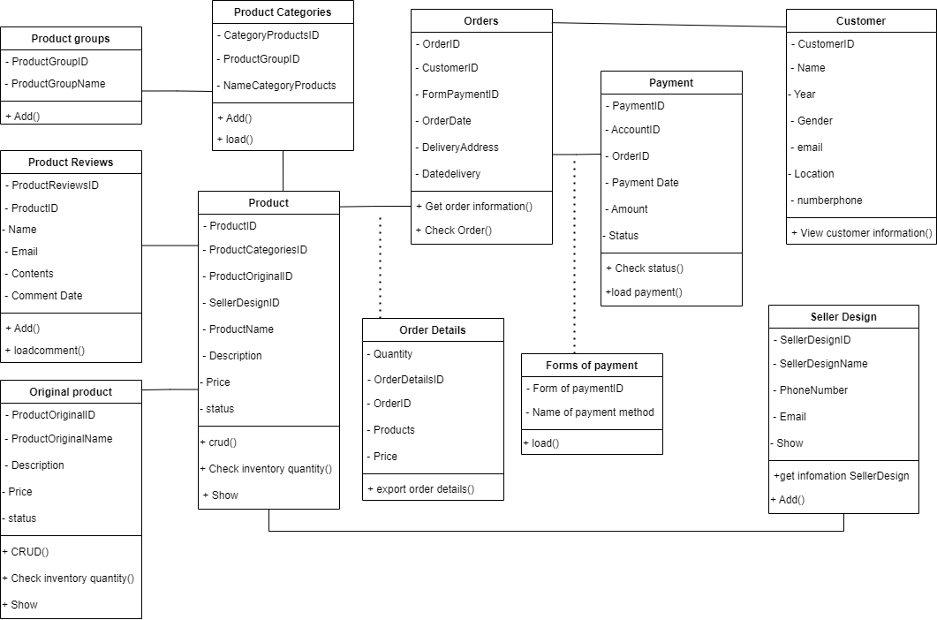
Class Diagram

Slide 12
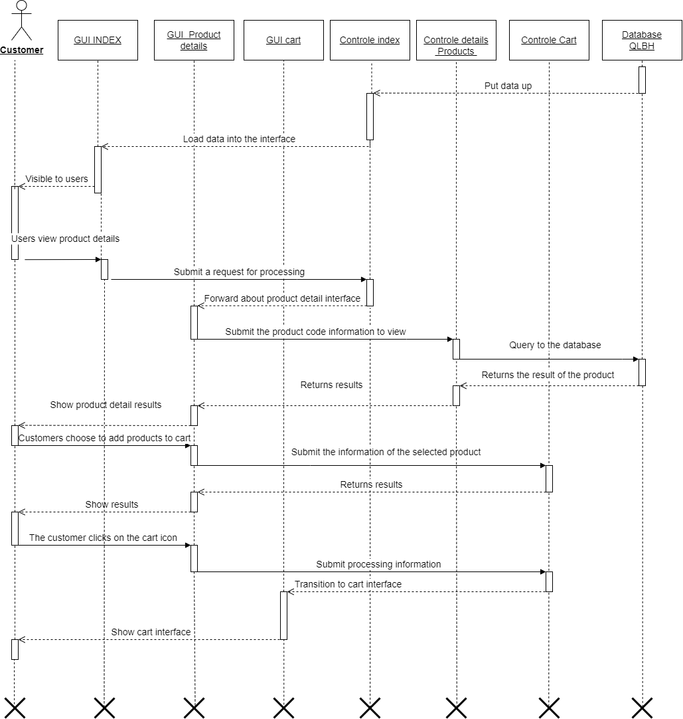
Sequence Diagram
Add product to cart

Slide 13
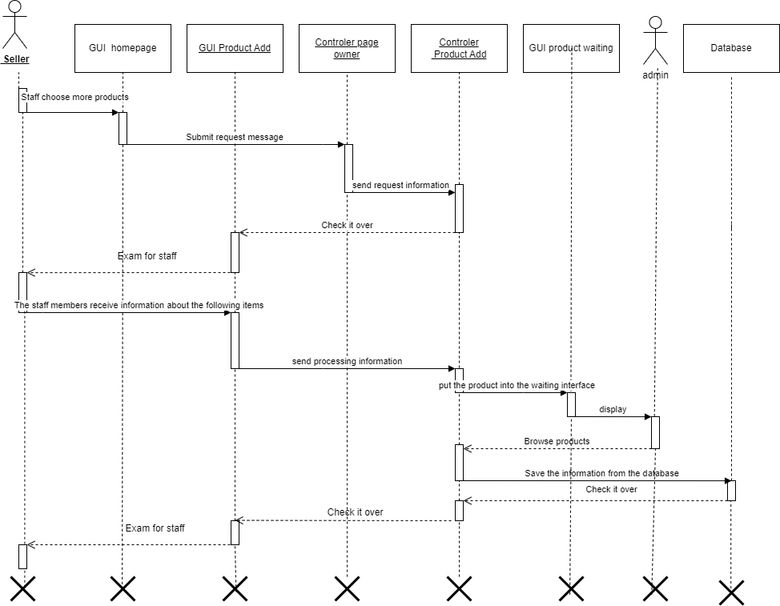
Sequence Diagram
Post products

Slide 14
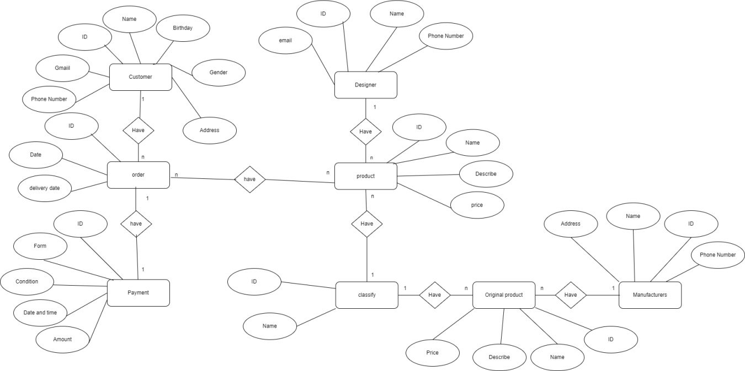
ENTITY RELATIONSHIP DIAGRAM

Slide 15
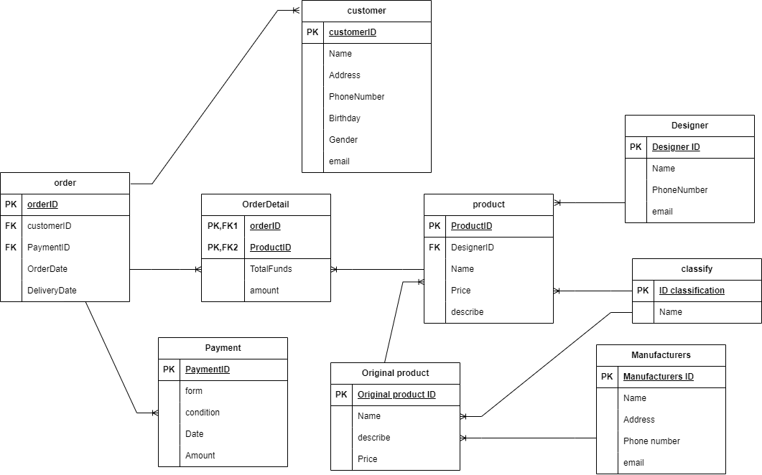
DATABASE

Slide 16
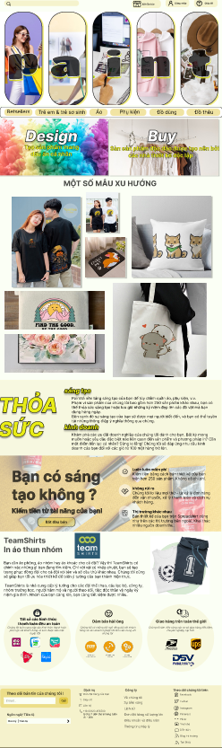
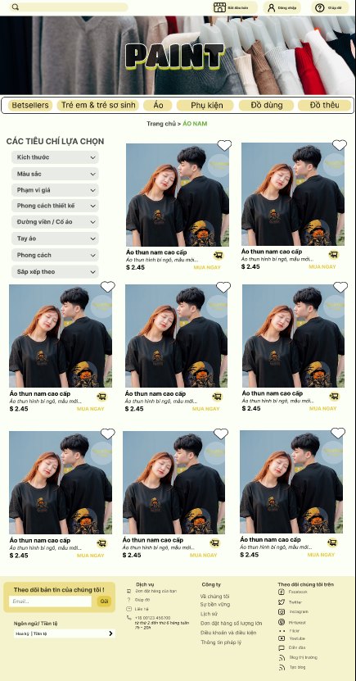
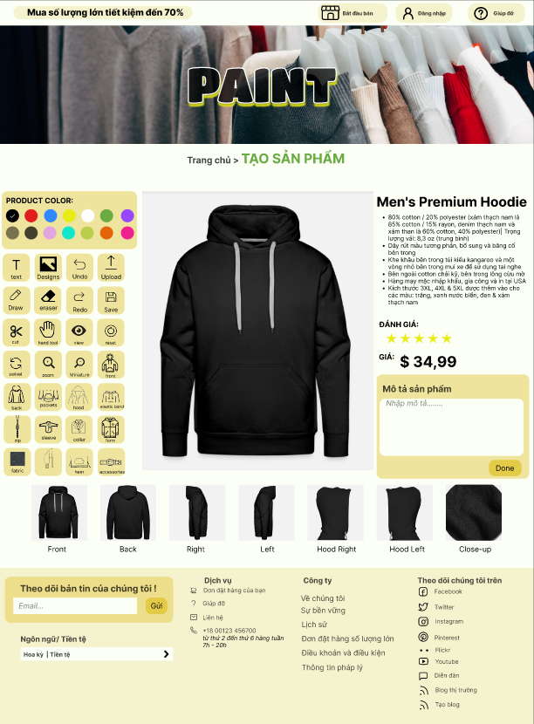
UI DESIGN
UI DESIGN (Figma)

Slide 17
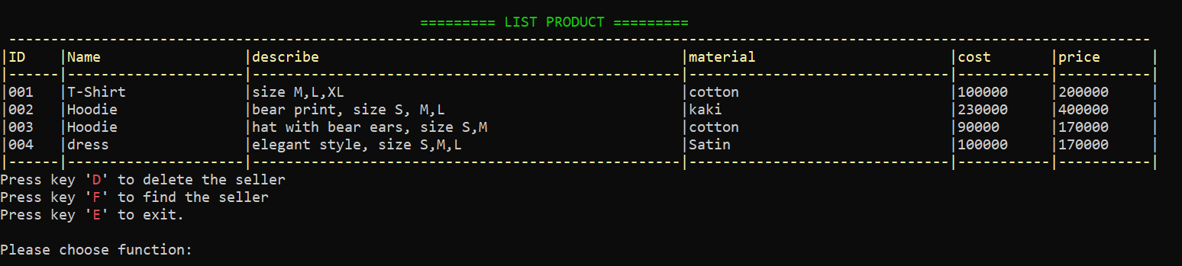
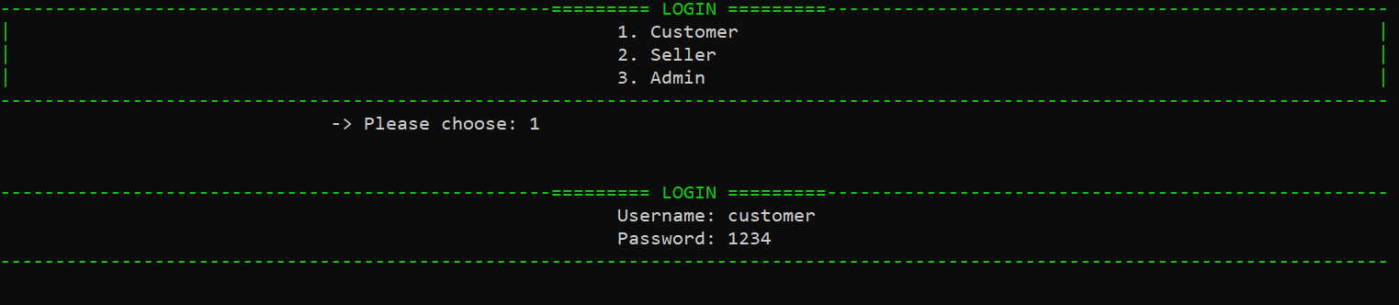
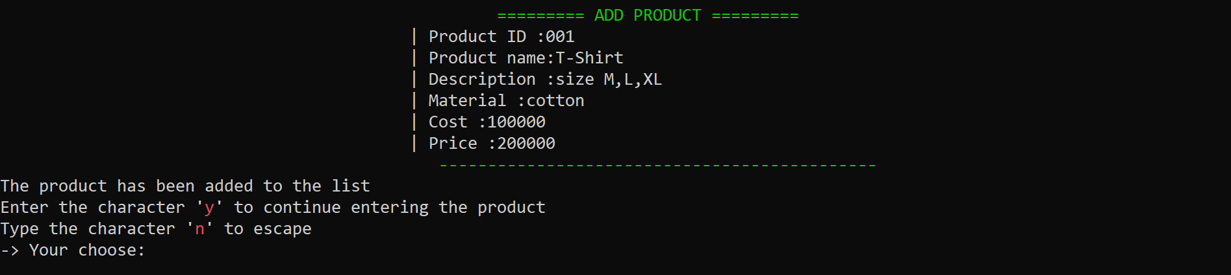
UI Design (C#)

Slide 18
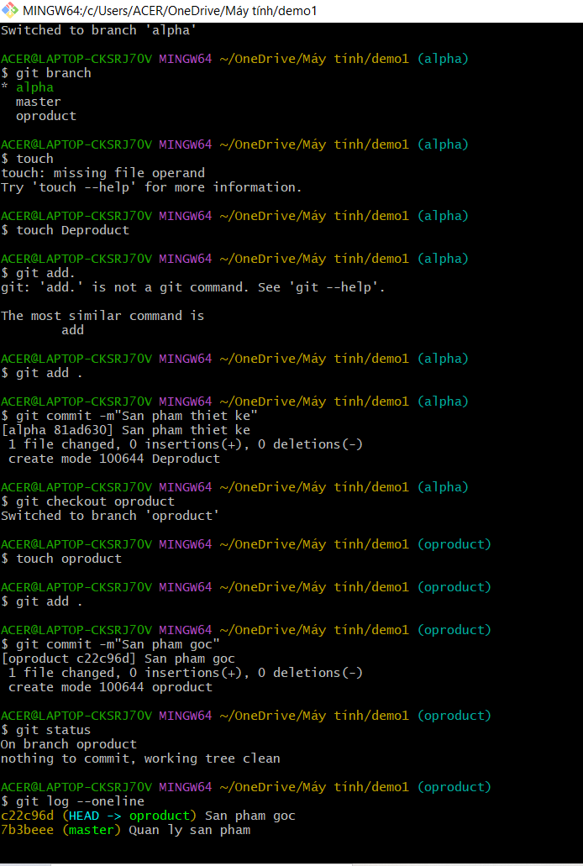
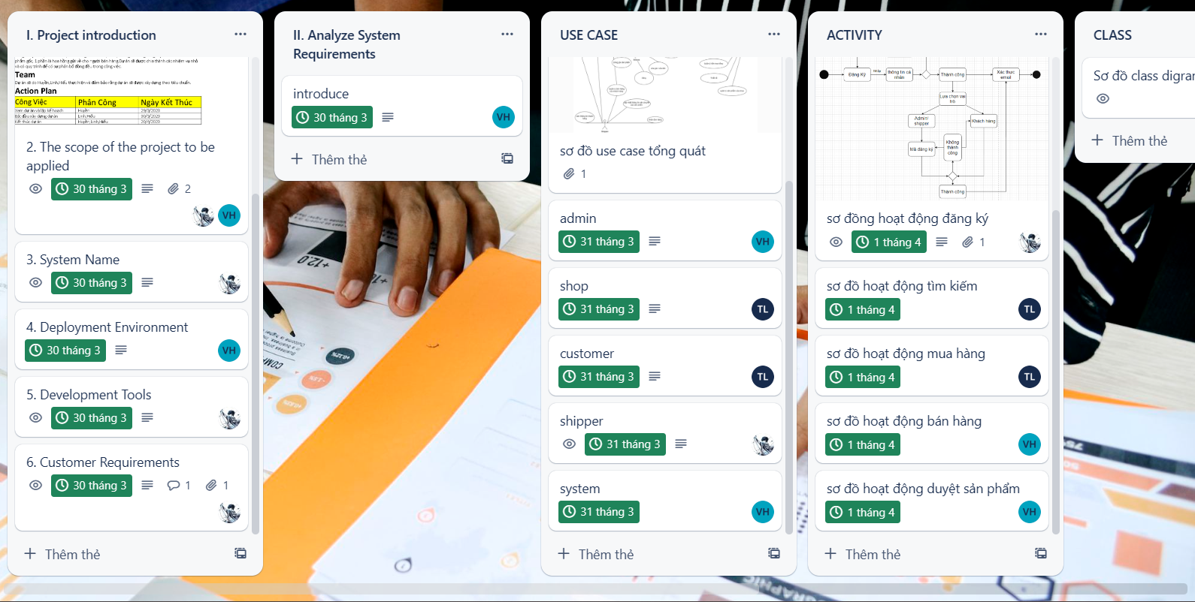
TASK ASSIGNMENT (TO EACH GROUP MEMBER)
Analyze (use case, activity, class diagram) : Thanh Huyền, Công Hiếu, Thùy Linh
Design : Database : Thanh Huyền
Figma: Thanh Huyền, Công Hiếu, Thùy Linh
Code : Thanh Huyền, Công Hiếu, Thùy Linh
Write Report: Thanh Huyền
Powerpoint : Công Hiếu

Slide 19
EXPERIENCE LEARNED
Analyze
Design
Teamwork skills
Reporting skills
Presentation skills
communication skills
Decision skills
Time management skills

Slide 20


Slide 21
Q & A

